Slide 1
MOHAMMAD Al-assaf
ABDALLAH AYMAN Task 2
Cellula Technologies

Slide 2
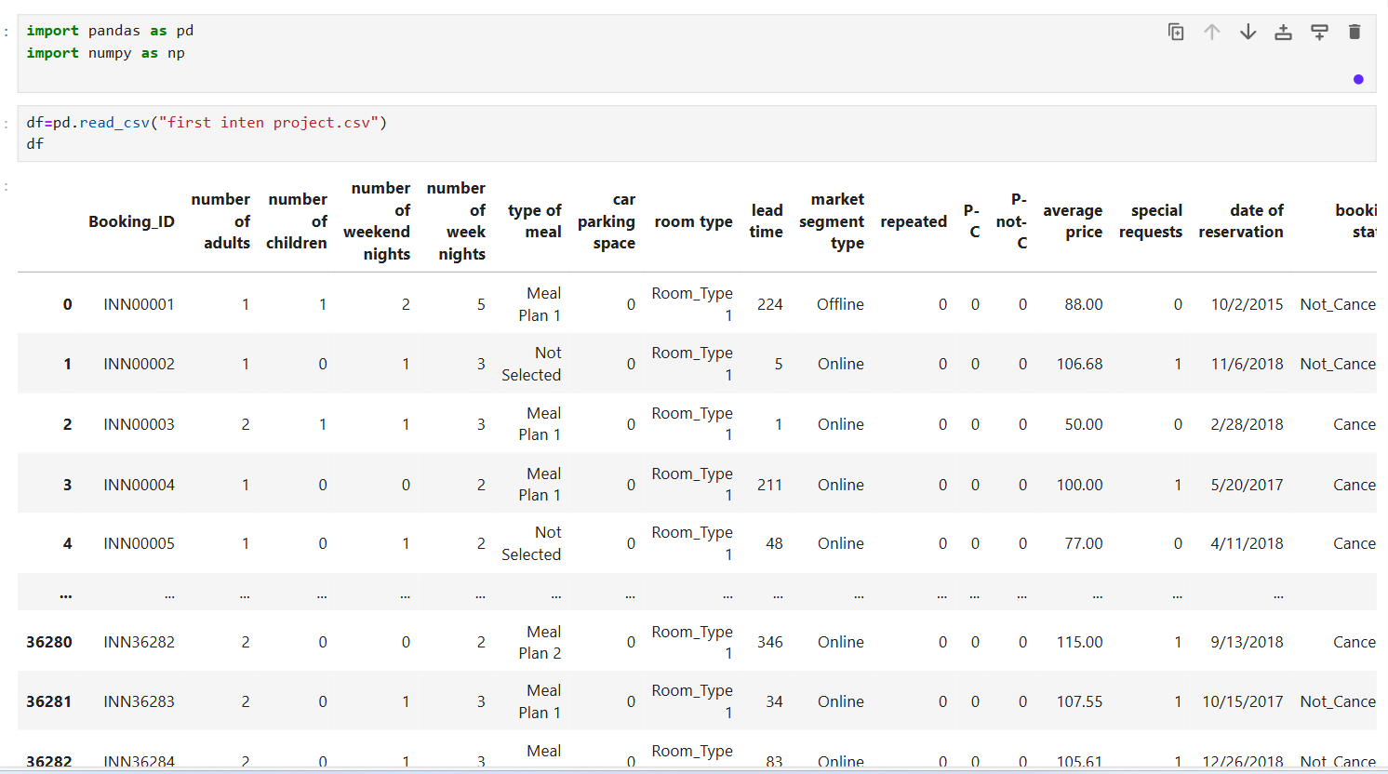
Data overview
We have 17 columns divided between categoric and numeric
The target column is booking status(cancel or not-cancel

Slide 3
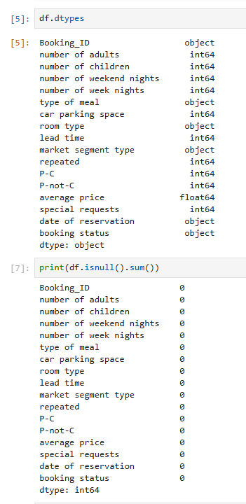
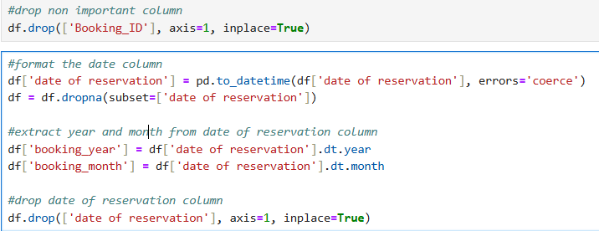
Data type and null-values cheCK
Its good that we don’t have and null values , which makes the preprocessing step easier.
We have 6 object columns and 11 numeric columns.
Drop non important column.
Extract year and month from date column.

Slide 4
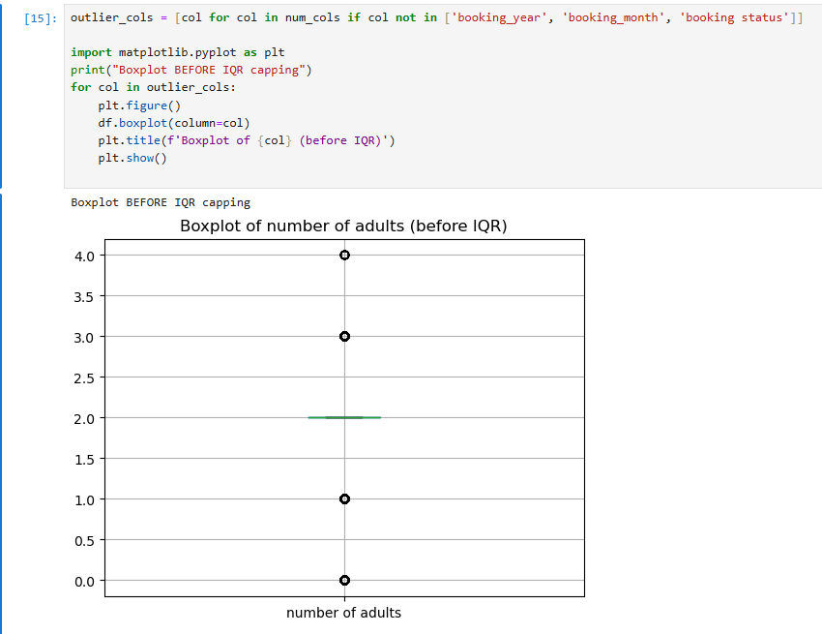
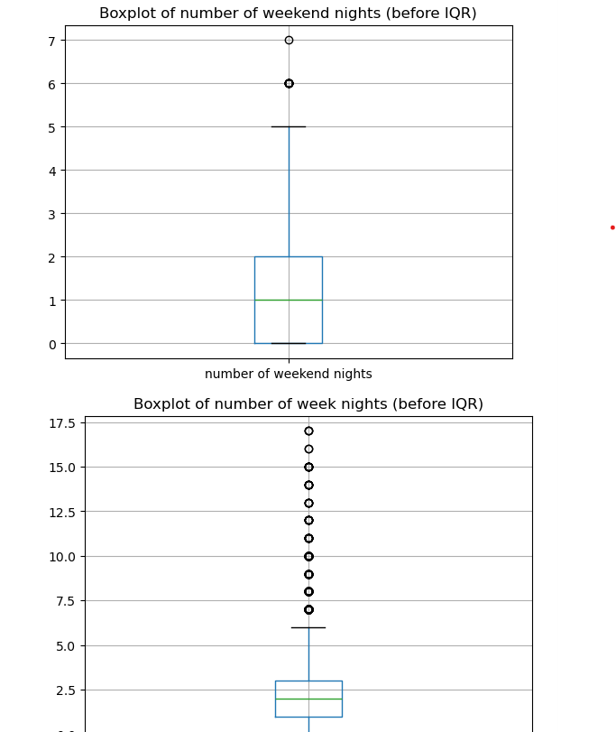
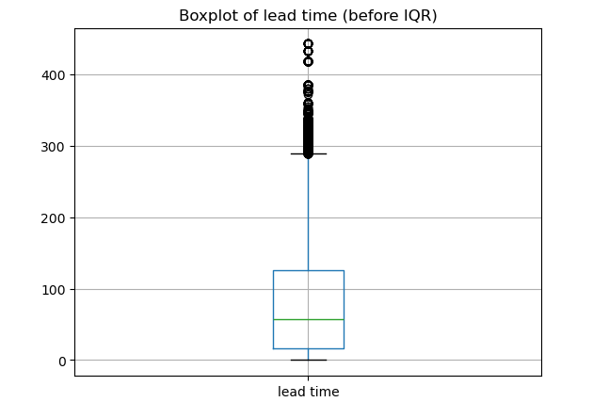
Outliers check
As we see , we have a lot of outliers in the many columns.
Because od this , we have to use outlier handle techniques such as iqr and z-score

Slide 5
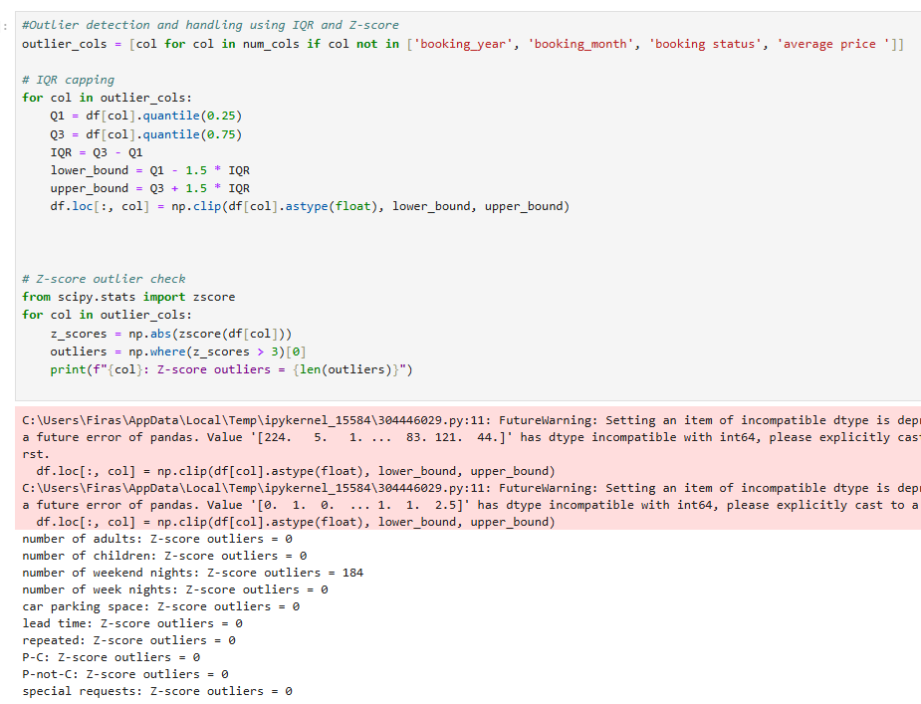
Iqr and z-score techniques
We observed that there are 184 outliers in the weekend nights column when using z-score. This is because most of the values were relatively small, such as 0 or 1 night. After calculating the mean and standard deviation, any significantly large value for example, 50 nights was considered an outlier.
The solution to this issue is to use the IQR method, as it is more effective in handling data that is not normally distributed.

Slide 6
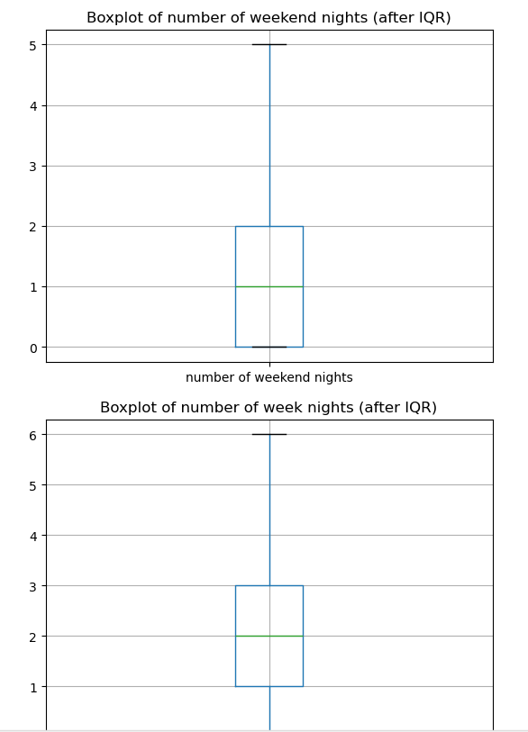
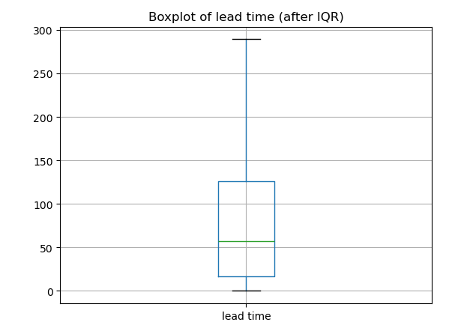
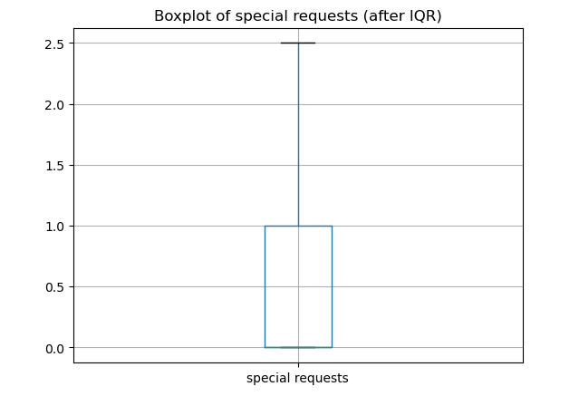
Outliers after iqr
We noticed a significant improvement in plots.

Slide 7
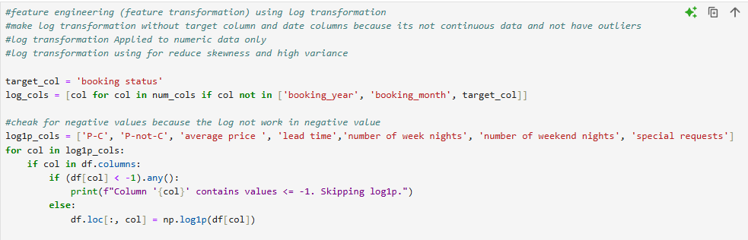
Feature transformation using log transformation

Slide 8
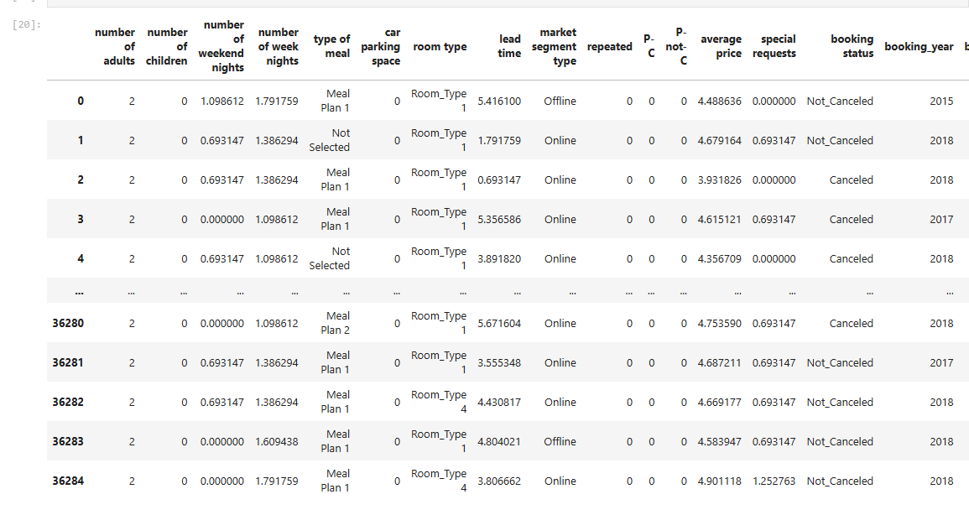
Data after log transformation

Slide 9
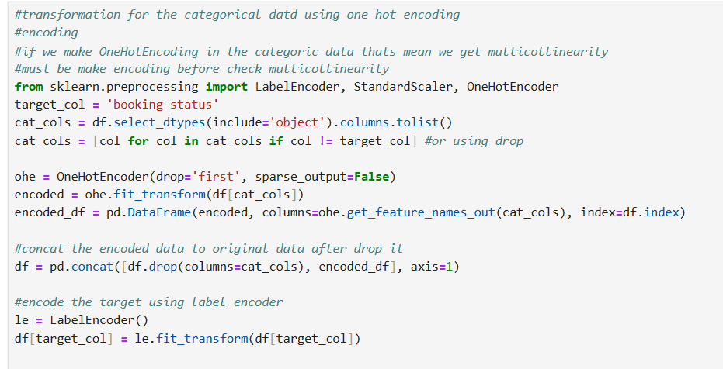
Encoding the categorical columns

Slide 10
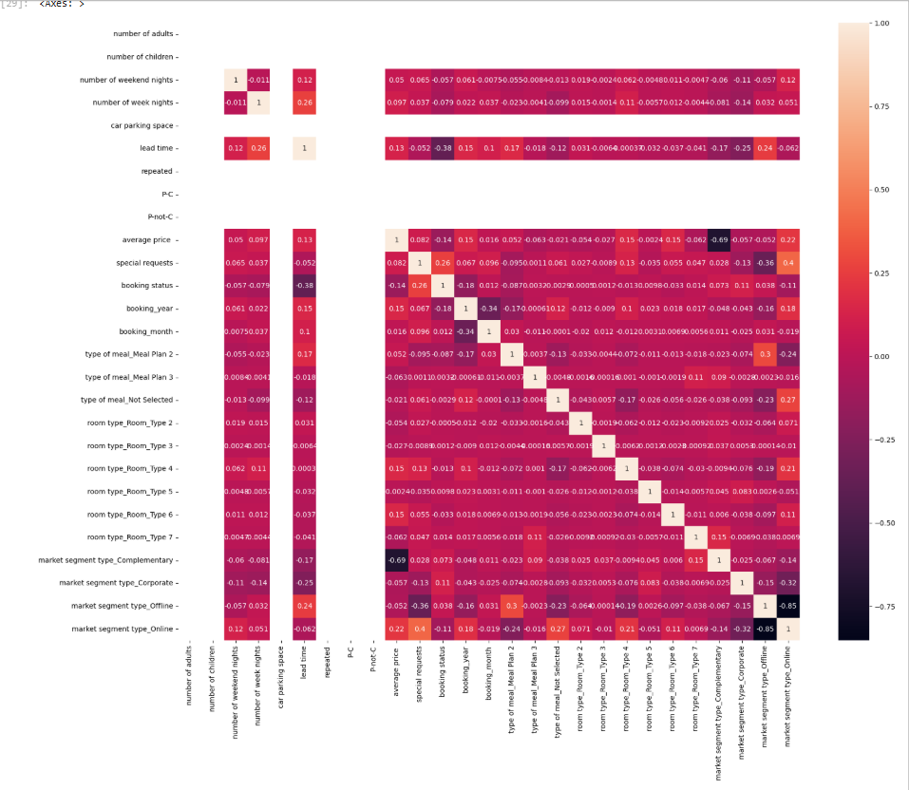
heatmap

Slide 11
Heatmap analysis
Strong correlations appear as values close to +1 or -1. According to the heatmap, there are strong correlations between some columns, which indicates the presence of multicollinearity. This is mainly due to encoding of some categorical columns, as well as similarity in values between certain columns, such as "P-C" and "P-not-C".
For handle the multicollinearity we use VIF (Variance Inflation Factor) .
Drop p-c and p-not-c manually because have Perfect Negative Correlation that’s mean the VIF may not be able to solve it.
P-c and p-not-c they reflect the same information in the same way but in opposite forms.

Slide 12
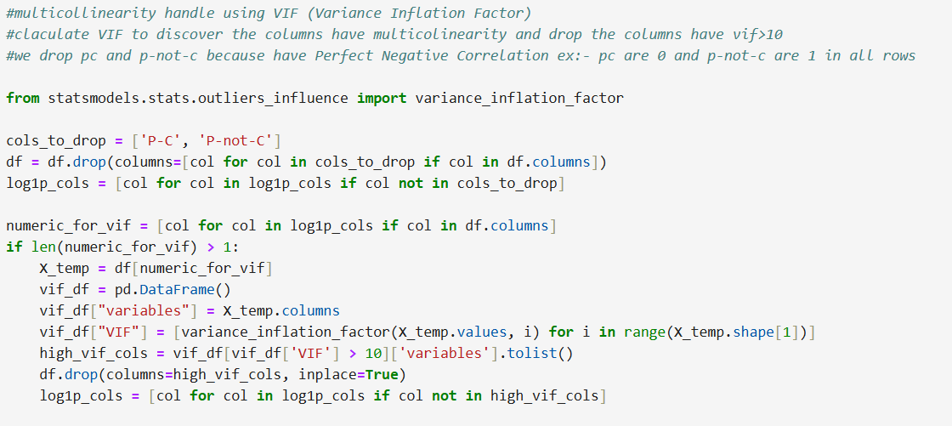
VIF (Variance Inflation Factor)

Slide 13
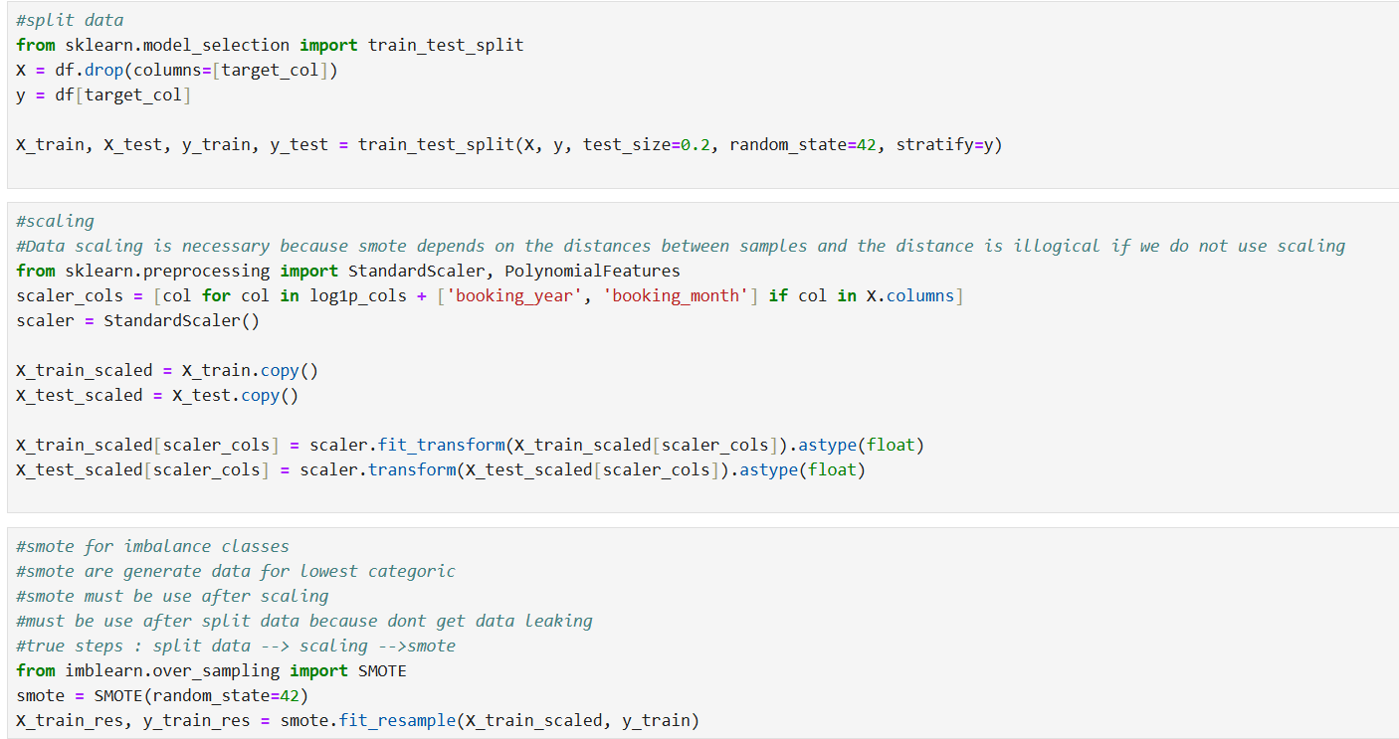
Split data and scaling and smote
We split the data before applying scaling to avoid data leakage This is because scaling involves a fit operation, which performs a statistical calculation. If scaling is done before the split, the model would indirectly gain information about the test data during training. After splitting and scaling, we applied SMOTE to handle imbalanced data.
SMOTE are generate data for lowest categoric
True steps : Split data --> Scaling -->SMOTE

Slide 14
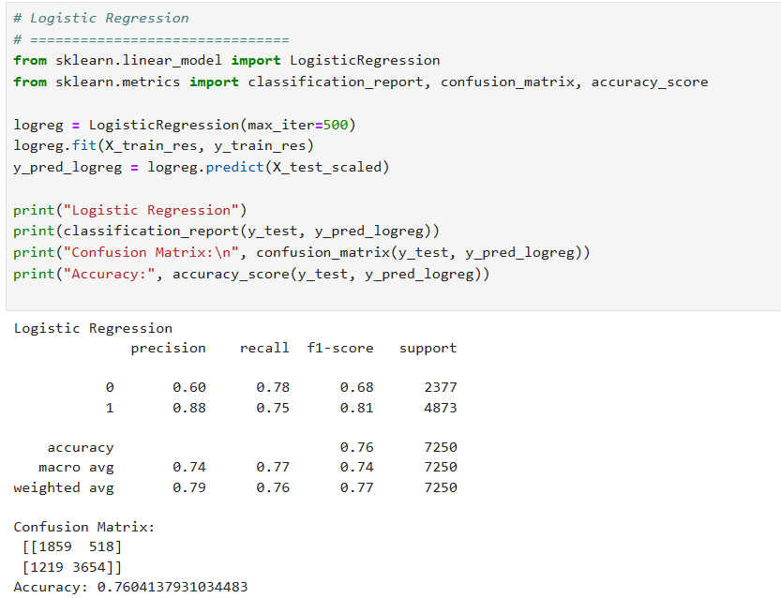
Logistic regression

Slide 15
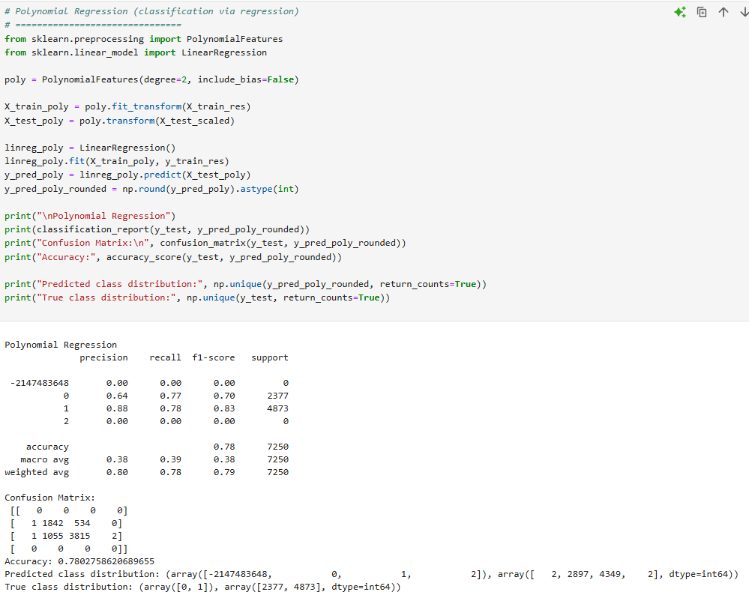
Polynomial regression

Slide 16
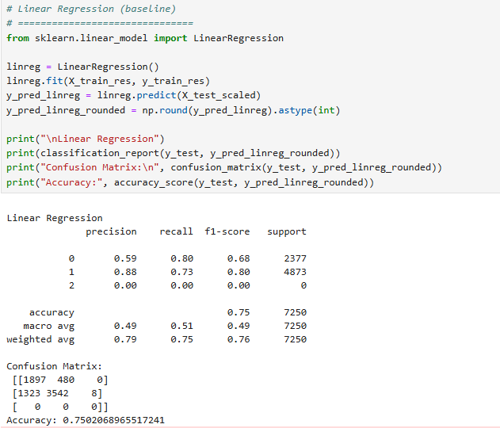
Linear regression

Slide 17
Thank you
Author by : Mohammad Al-assaf
Abdallah Ayman

